Slide 1

The Sneaker Collector
Project 2 – Team 1:
Bill Geng, Eleonore Caclard, Jason Grossman, Neil Hall, Sumant Singh

Slide 2
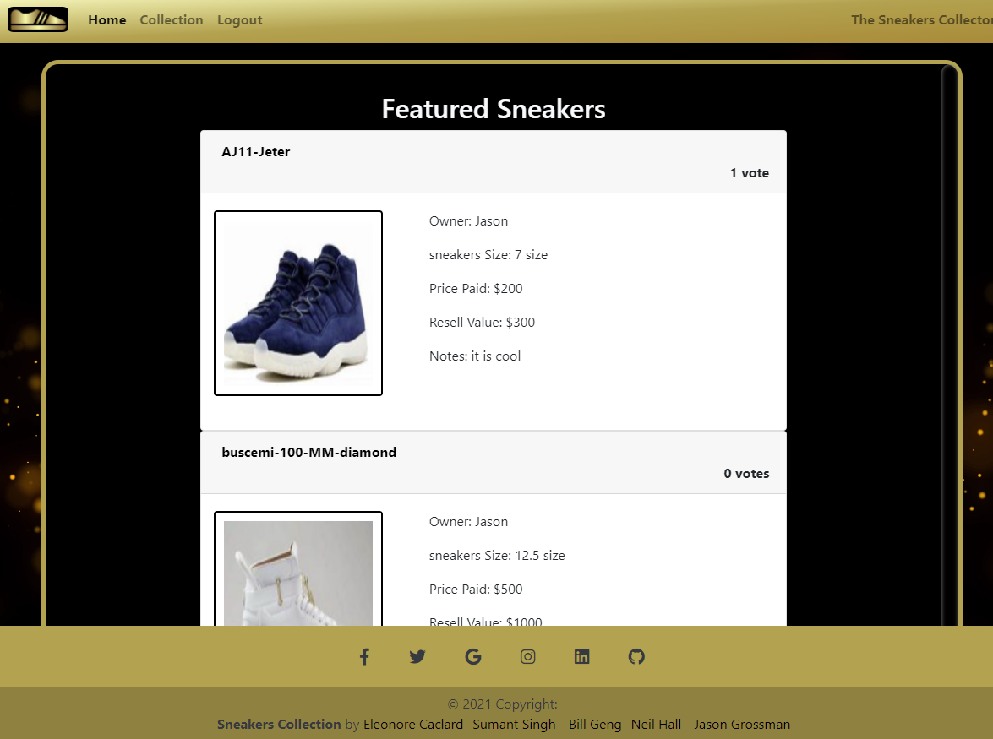
Description of Application
Create Your Own Collection
As a collector of quality Sneakers,
I want to track my collection,
Add personal observations/comments to my catalogue,
Share my collection with others, and
Search for rare Sneakers to add to my collection.

Slide 3
Technical Specifications
Node Packages
API CRUD Routes
Bcrypt
Bulma
Connect-session-sequelize
Dotenv
Express
Express-handlebars
Express-session
Jest
Lodash
Mysql2
Nodemon
Sequelize
Sneakers:
Get (all, one)
Post
Put
Delete
User:
Get (all, one)
Post (signup, login, logout)
Put
Delete
Comments:
Get (all)
Post
Delete
Upvote

Slide 4
Challenges & Successes
Challenges
Successes
Merging Conflicts
Getting server up and running
Troubleshooting Node Packages
Deployment
Aligned on an idea early on.
Distribution of responsibilities
Communication & Helping each other
Planning and Execution

Slide 5
Roles & Responsibilities
Eleonore: Handlebars, MySQL database, Javascript
Neil: Model creation, User stories
Bill: Testing, Troubleshooting
Sumant: Front end Viewer, External Libraries
Jason: Express API Routes, Powerpoint

Slide 6
Future Development Opportunities
Image Manager (User upload)
In-app sharing functionality
Shoppable connection to e-commerce endpoint

Slide 7
Demo
A Walkthrough of our application at work
Github: https://github.com/UofTL/the-sneakers-collector
Heroku: https://stormy-wave-68711.herokuapp.com/

Slide 8
Questions & Answers

